Slide 1
FINAL TEAM PROJECT DEMO
TEAM 1234
FARIDA BALOGUN , MUHAMMED MIAD, MOHMED BEMAT, LINWEI ZHENG, NISCHAL THAPA, SHAEEM ROCKCLIFFE

Slide 2
TICKETR
Ticketr is a centralized campus event ticketing and revenue system designed to streamline the way students discover events and how organizations manage them. It bridges the gap between campus life and digital management.
CORE SERVICES:
- For Students/Visitors: A central hub to browse events, an AI chatbot for personalized recommendations, secure ticket purchasing, and digital QR code entry.
- For Organizations: Tools to create and manage events, track real-time attendance, and generate detailed revenue/attendance reports via Excel.
- VIP Features: Early access registration for popular events and exclusive status for premium users.

Slide 3
TABLE OF CONTENTS
03
05
01
02
04
Tech
Stack
2NF
DIAGRAM
Learning Curve
Profit
Model
User and Host
Journey

Slide 4
01
TECH STACK

Slide 5
Frontend: React.js
  User interface for both the student ticketing portal and the organizer dashboard.
Backend: Python (Flask)
  Serves as the API layer, handling logic between the frontend and the database, including the AI chatbot integration.
Database: MySQL
  Stores persistent relational data for Users, Events, Tickets, and Payments in a structured 2NF format.
Deployment: Docker
  Containerizes the application services to ensure consistent environments across development and production.
Report: Excel Integration
  Automated generation of attendance and revenue spreadsheets for organizations.

Slide 6
02
PROFIT MODEL

Slide 7
Commission: We take a 5-10% service fee on every paid ticket sold through the platform.
Event Page "Rental": Organizations pay a tiered fee to host their event pages, based on the volume of attendees or "Premium" organization status.
Advertising & Sponsorships:
  Banner Ads: Local businesses or campus partners can purchase ad space (ADVERTISEMENTS table).
  Featured Events: Hosts can pay for "Recommendation spots" to appear at the top of the feed or be suggested by the AI Chatbot.
VIP Memberships: Students can purchase a VIP status for early access to tickets (vip_access_time), generating subscription-like revenue.

Slide 8
03
2NF DIAGRAM

Slide 9
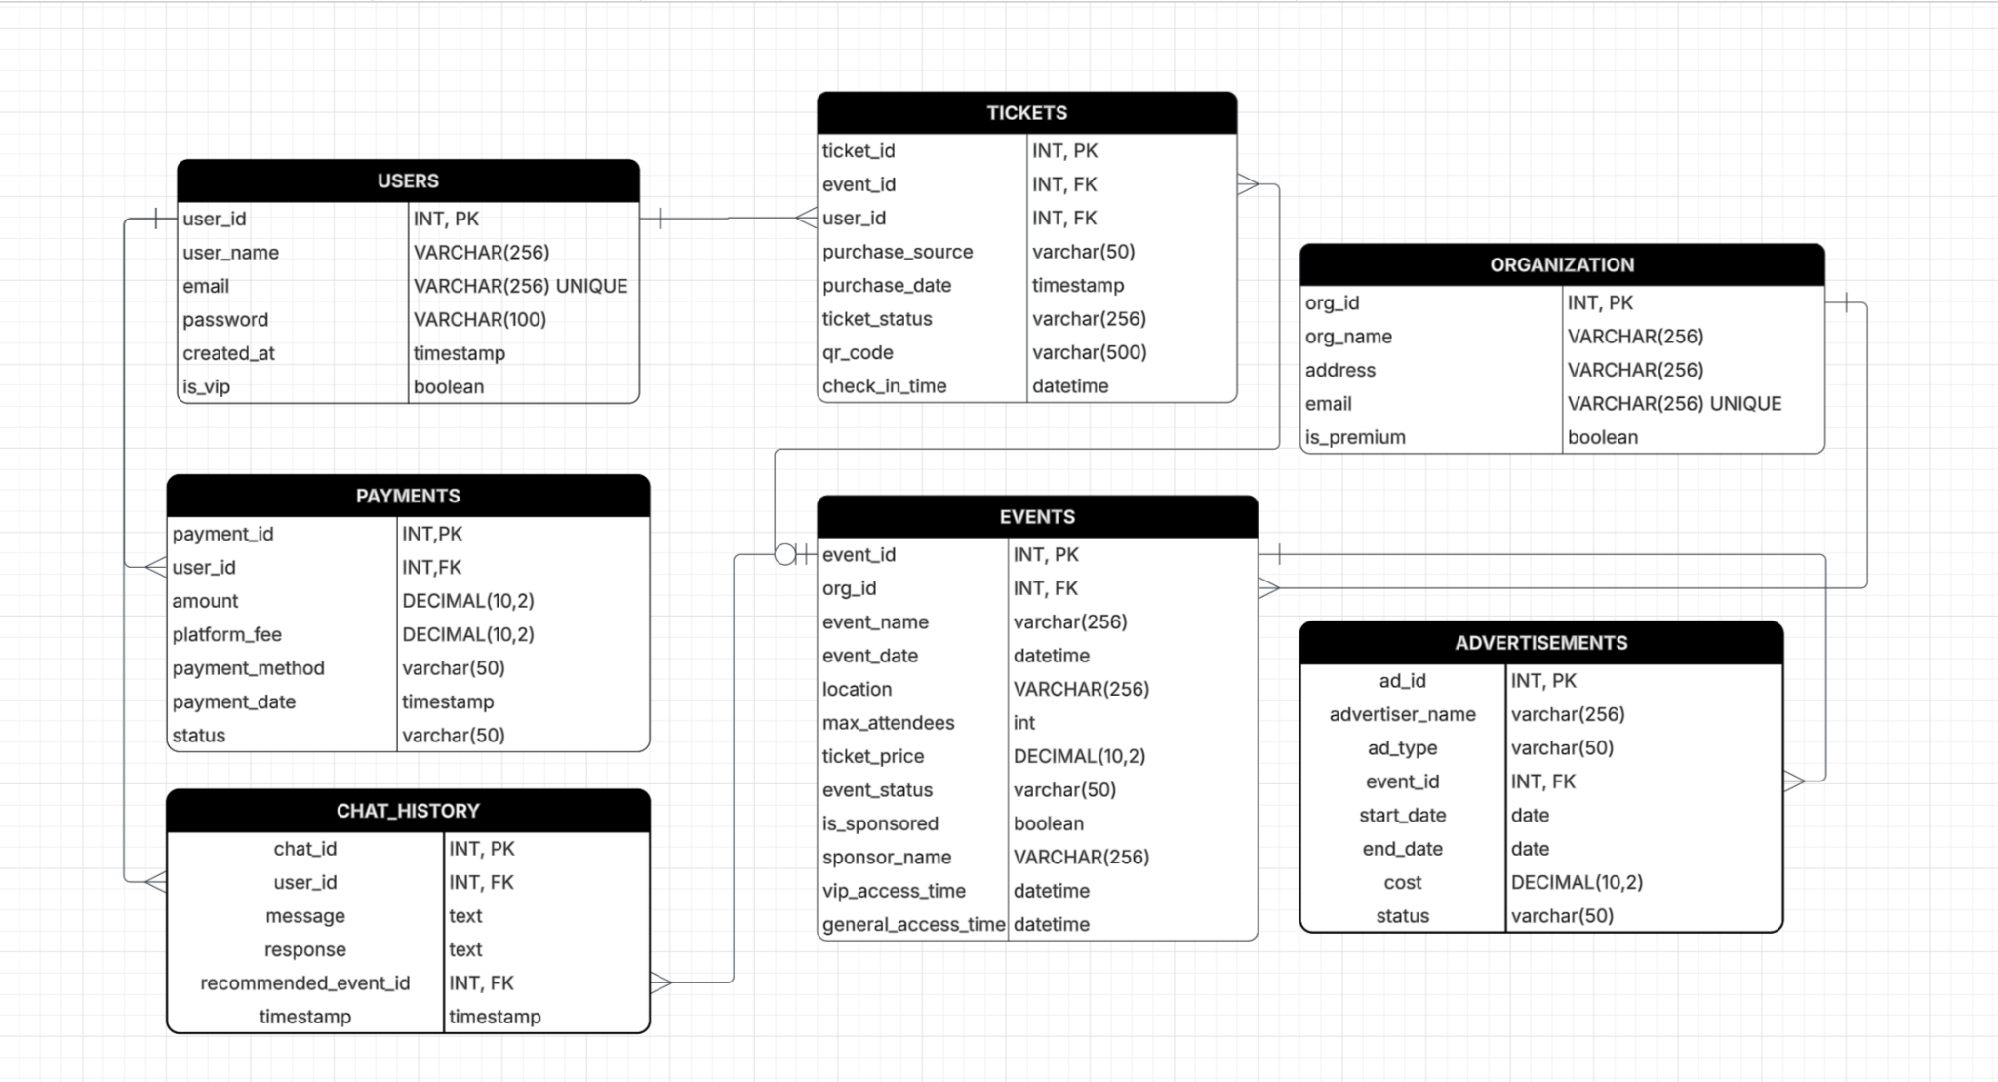

Slide 10
04
USER & HOST JOURNEY
FLOW DIAGRAM

Slide 11
USER JOURNEY
LOGIN
Sarah, a student, logs in looking for something interesting but she’s broke. She asks the AI Chatbot for affordable suggestions. The bot recommends cheaper if not She purchases a ticket, pays instantly, and receives a QR code. At the door, she scans in.
HOMEPAGE
(chatbot)
SELECT EVENT
PAYMENT
TICKET
QR/TICKET CLIP

Slide 12
HOST JOURNEY
ADMIN LOGIN
The "Chess Club" wants to host a tournament. The admin logs in, creates the event with a VIP early bird time, and sets the ticket price. As tickets sell, they monitor the dashboard. After the event, they export an Excel sheet to see total revenue.
CREATE EVENT
(Set Date/Price/VIP)
Publish Event
Monitor Dashboard
Check-in Attendees
Revenue Report

Slide 13
05
LEARNING CURVE
WHAT DID WE LEARN THIS SEMESTER

Slide 14
This semester, we implemented Docker for the first time to containerize our React and Flask services. This drastically reduced debugging time and taught us modern DevOps practices used in the industry."
We all also learned about the full stack development workflow. How to coordinate developing the frontend, backend and database
And finally, we learned how to communicate technical ideas to each other. Explaining APIs and react components to each other

Slide 15
THANK YOU!
Do you have any questions?

